Slide 1

Algebra 1
Unit 2, Lesson 2 Applying Quotient Laws of Exponents to Algebraic Expressions Volume 1, pg. 61

Slide 2


Benchmark
MA.912.NSO.1.2
Generate equivalent algebraic expressions using the properties of exponents.
volume 1, pg. 61

Slide 3
Integrated Mathematical Thinking and Reasoning Standards
MA.K12.MTR.2.1 Demonstrate understanding by representing problems in multiple ways.
MA.K12.MTR.4.1 Engage in discussions that reflect on the mathematical thinking of self and others.
MA.K12.MTR.5.1 Use patterns and structure to help understand and connect mathematical concepts.
volume 1, pg. 61

Slide 4

Learning Target
I can generate equivalent algebraic expressions to find the quotient of two monomials using the properties (laws) of exponents.
volume 1, pg. 61

Slide 5

Warm-Up
volume 1, pg. 62

Slide 6
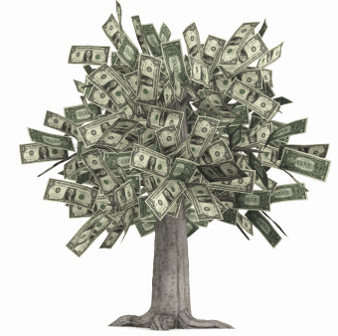
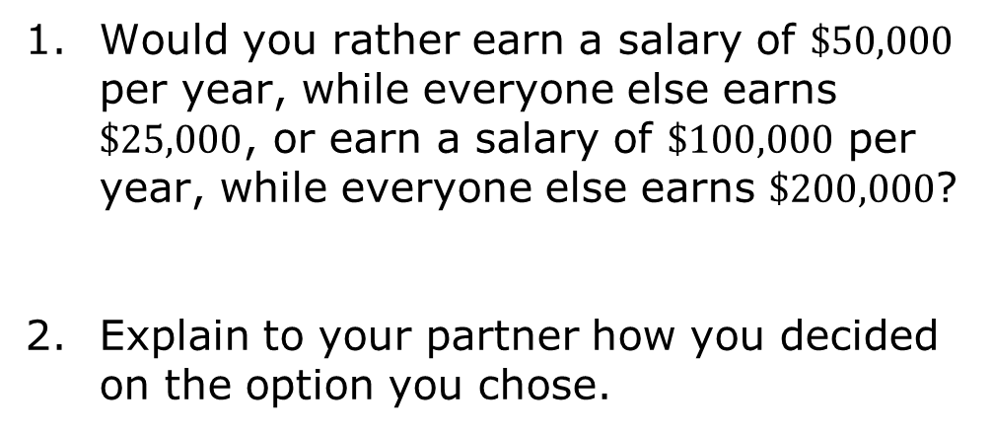
2.2.1 Warm-Up: Would You Rather?
Would you rather earn a salary of $\$50,000$ per year, while everyone else earns $\$25,000$, or earn a salary of $\$100,000$ per year, while everyone else earns $\$200,000$?
Explain to your partner how you decided on the option you chose.
volume 1, pg. 62
Notes:
Video Link: https://algebranation.wistia.com/medias/fi4fidi5y8

Slide 7

Guided Instruction
volume 1, pg. 62

Slide 8
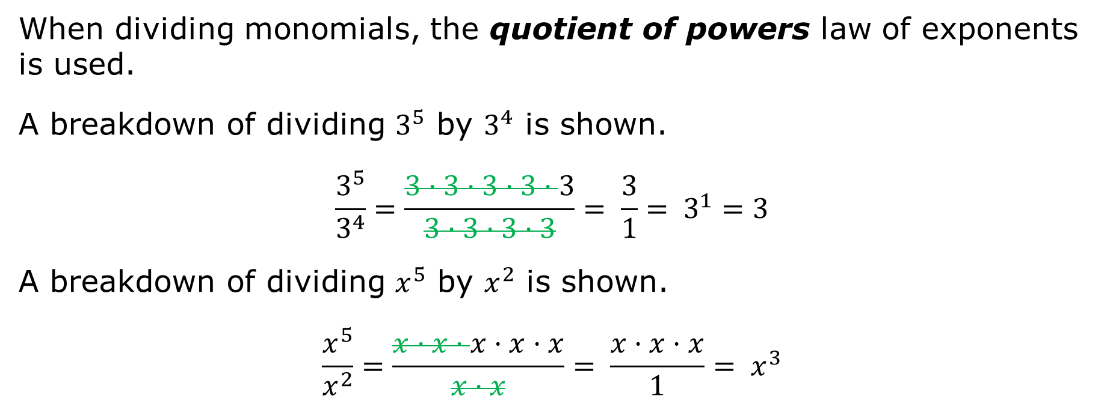
2.2.2 Guided Instruction: Quotient of Powers
When dividing monomials, the quotient of powers law of exponents is used.
A breakdown of dividing $3^{5}$ by $3^{4}$ is shown.
$$\frac{3^{5}}{3^{4}}=\frac{3·3·3·3·3}{3·3·3·3}= \frac{3}{1}= 3^{1}=3$$
A breakdown of dividing $x^{5}$ by $x^{2}$ is shown.
$$\frac{x^{5}}{x^{2}}=\frac{x·x·x·x·x}{x·x}= \frac{x·x·x}{1}= x^{3}$$
volume 1, pg. 62

Slide 9
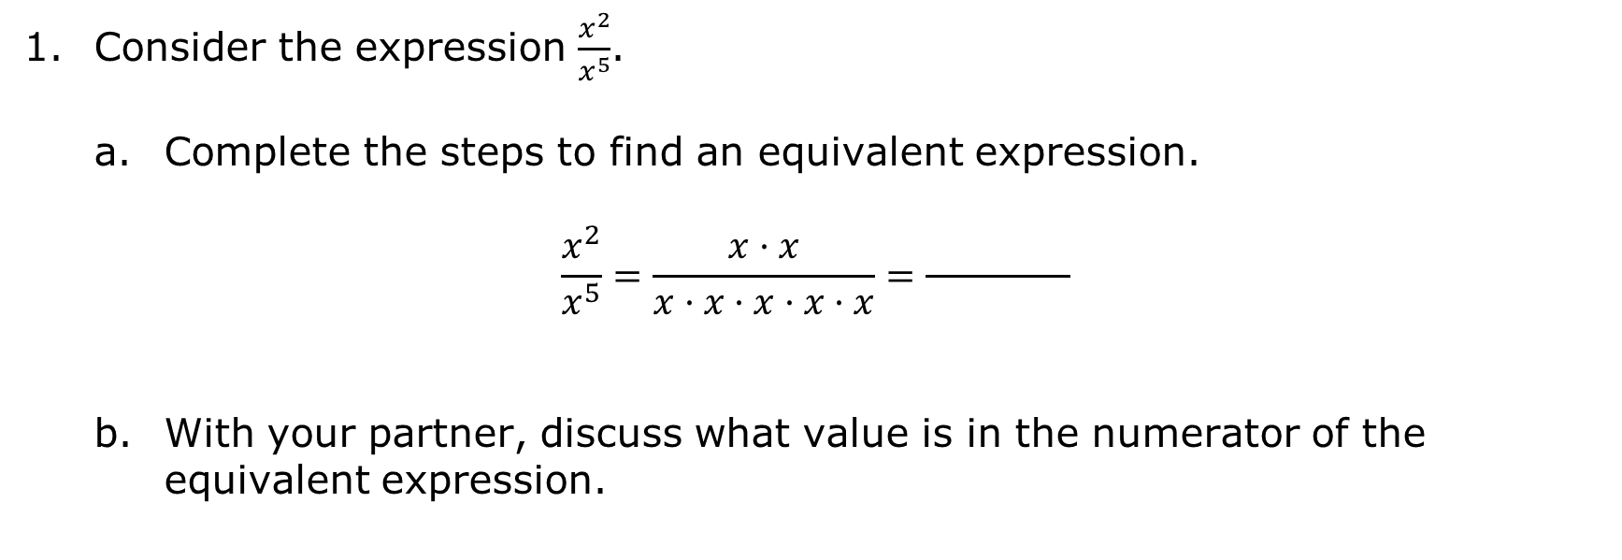
Consider the expression $\frac{x^{2}}{x^{5}}$.
Complete the steps to find an equivalent expression.
$$\frac{x^{2}}{x^{5}}=\frac{x·x}{x·x·x·x·x}=\frac{ }{ }$$
With your partner, discuss what value is in the numerator of the equivalent expression.
volume 1, pg. 62

Slide 10

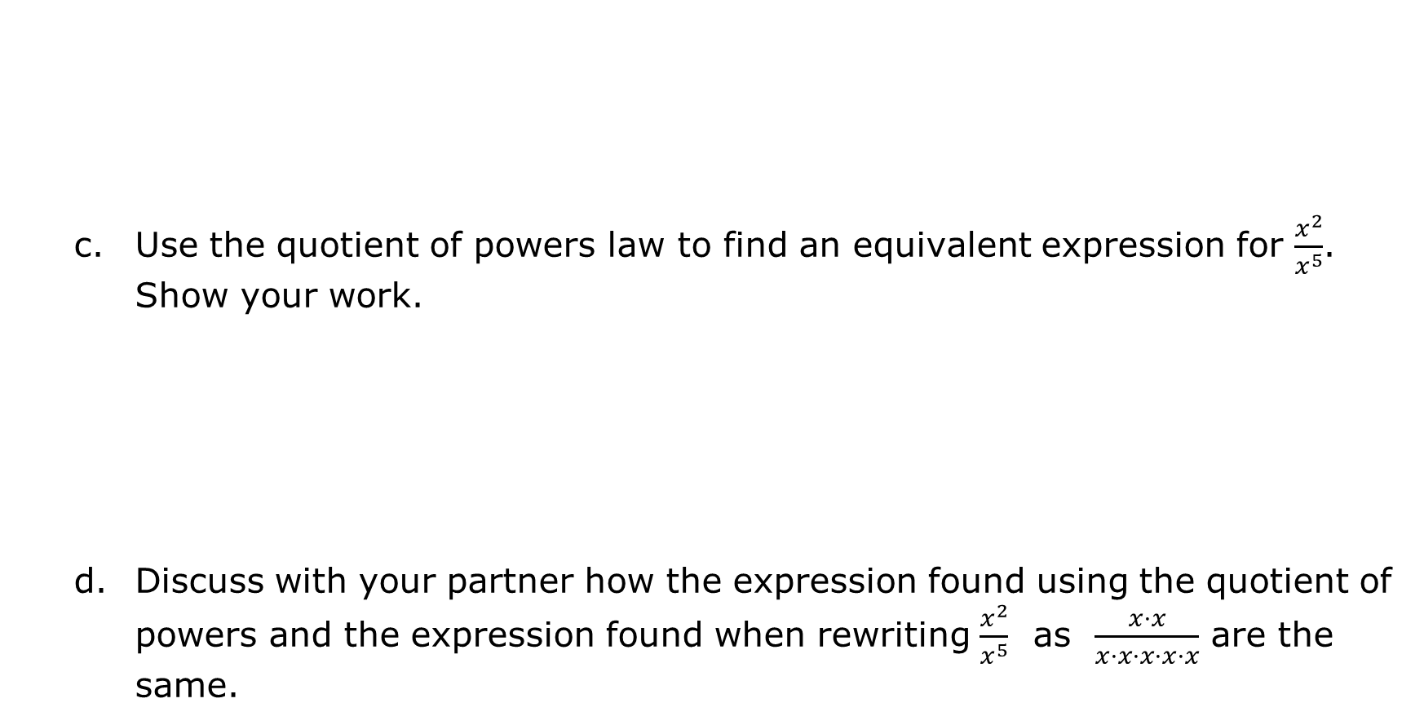
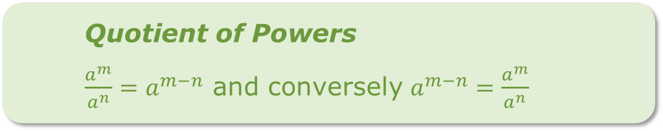
Quotient of Powers
$\frac{a^{m}}{a^{n}}=a^{m−n}$ and conversely $a^{m−n}=\frac{a^{m}}{a^{n}}$
Use the quotient of powers law to find an equivalent expression for $\frac{x^{2}}{x^{5}}$. Show your work.
Discuss with your partner how the expression found using the quotient of powers and the expression found when rewriting $\frac{x^{2}}{x^{5}}$ as $\frac{x·x}{x·x·x·x·x}$ are the same.
volume 1, pg. 63

Slide 11
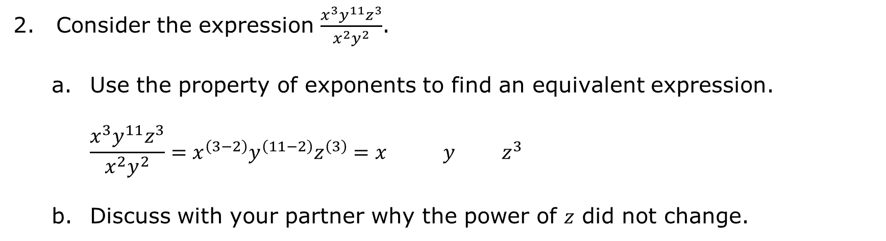
Consider the expression $\frac{x^{3}y^{11}z^{3}}{x^{2}y^{2}}$.
Use the property of exponents to find an equivalent expression.
$$\frac{x^{3}y^{11}z^{3}}{x^{2}y^{2}}=x^{\left(3−2\right)}y^{\left(11−2\right)}z^{\left(3\right)}=x y z^{3}$$
Discuss with your partner why the power of 𝑧 did not change.
volume 1, pg. 63

Slide 12
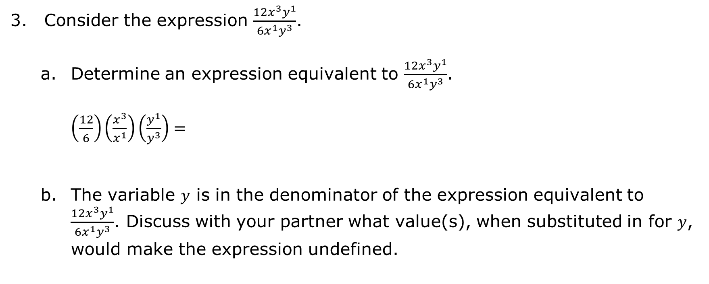
Consider the expression $\frac{{12x}^{3}y^{1}}{{6x}^{1}y^{3}}$.
Determine an expression equivalent to $\frac{{12x}^{3}y^{1}}{{6x}^{1}y^{3}}$.
$\left(\frac{12}{6}\right)\left(\frac{x^{3}}{x^{1}}\right)\left(\frac{y^{1}}{y^{3}}\right)=$
The variable 𝑦 is in the denominator of the expression equivalent to $\frac{{12x}^{3}y^{1}}{{6x}^{1}y^{3}}$. Discuss with your partner what value(s), when substituted in for 𝑦, would make the expression undefined.
volume 1, pg. 63

Slide 13
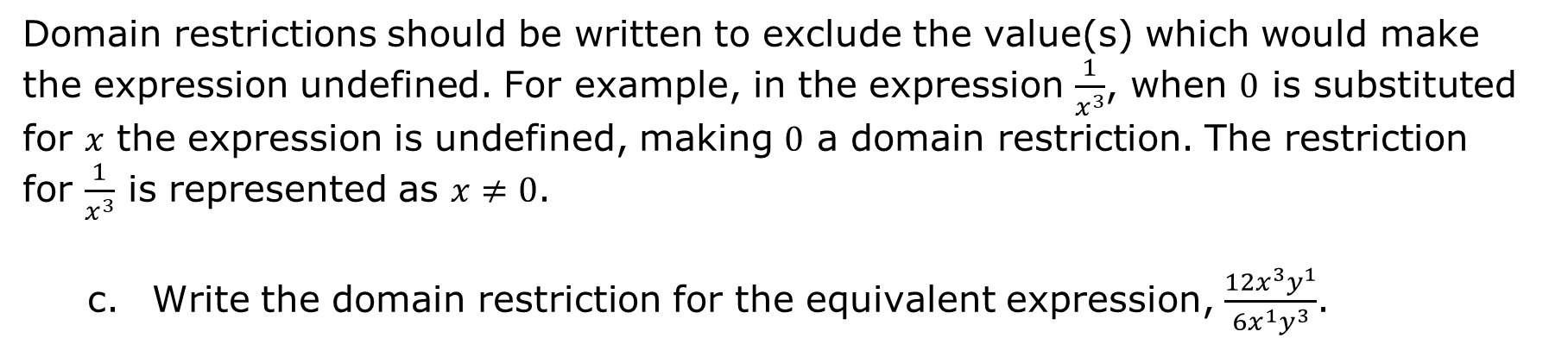
Domain restrictions should be written to exclude the value(s) which would make the expression undefined. For example, in the expression $\frac{1}{x^{3}}$, when $0$ is substituted for 𝑥 the expression is undefined, making $0$ a domain restriction. The restriction for $\frac{1}{x^{3}}$ is represented as $x≠0$.
Write the domain restriction for the equivalent expression, $\frac{{12x}^{3}y^{1}}{{6x}^{1}y^{3}}$.
volume 1, pg. 64

Slide 14

Guided Practice
volume 1, pg. 64

Slide 15

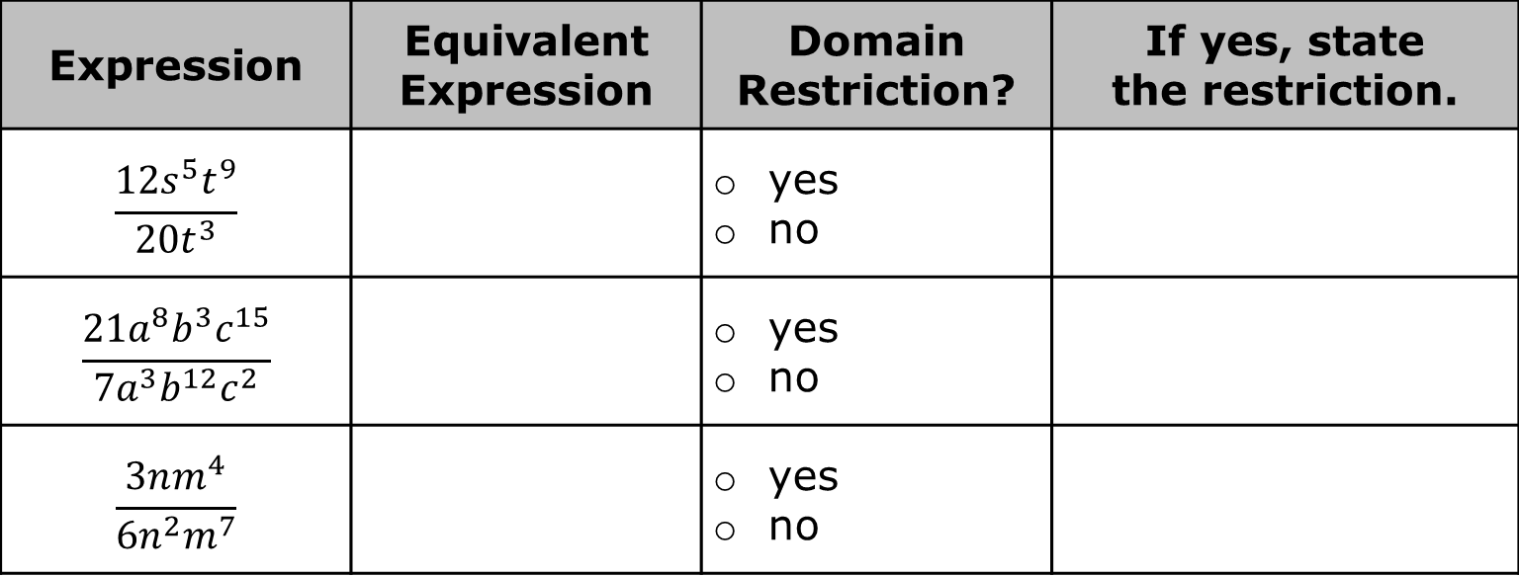
2.2.3 Guided Practice: Generating Equivalent Algebraic Expressions Using Quotient of Powers
Complete the table for each expression.
Expression | Equivalent Expression | Domain Restriction? | If yes, state the restriction.
$$\frac{12s^{5}t^{9}}{{20t}^{3}}$$ |  | yes no
$$\frac{21a^{8}b^{3}c^{15}}{7a^{3}b^{12}c^{2}}$$ |  | yes no
$$\frac{3nm^{4}}{6n^{2}m^{7}}$$ |  | yes no
volume 1, pg. 64

Slide 16
Guided Instruction
volume 1, pg. 65

Slide 17
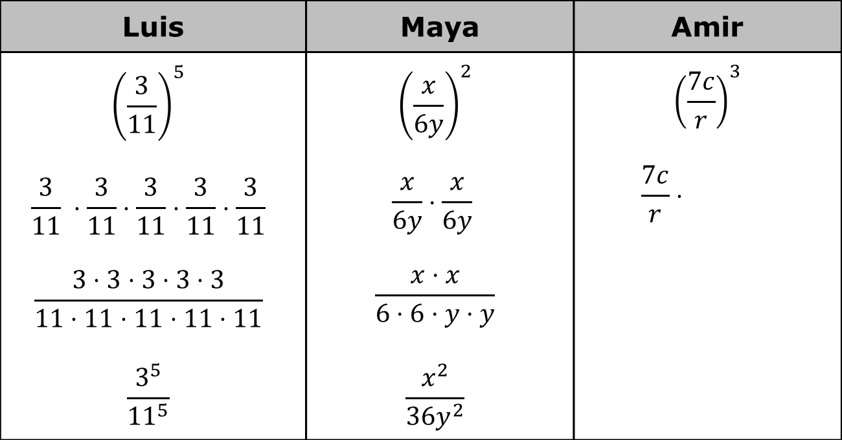
2.2.4 Guided Instruction: Power of a Quotient
Three students generated equivalent expressions using exponent laws.
Finish Amir’s work using a similar strategy to the one used by Luis and Maya.
Luis | Maya | Amir
$${\left(\frac{3}{11}\right)}^{5}$$ $$\frac{3}{11} ⋅\frac{3}{11}⋅\frac{3}{11}⋅\frac{3}{11}⋅\frac{3}{11}$$ $$\frac{3⋅3⋅3⋅3⋅3}{11⋅11⋅11⋅11⋅11}$$ $$\frac{3^{5}}{{11}^{5}}$$ | $${\left(\frac{x}{6y}\right)}^{2}$$ $$\frac{x}{6y}⋅\frac{x}{6y}$$ $$\frac{x⋅x}{6⋅6⋅y⋅y}$$ $$\frac{x^{2}}{{36y}^{2}}$$ | $${\left(\frac{7c}{r}\right)}^{3}$$ $$\frac{7c}{r}⋅$$
volume 1, pg. 65

Slide 18
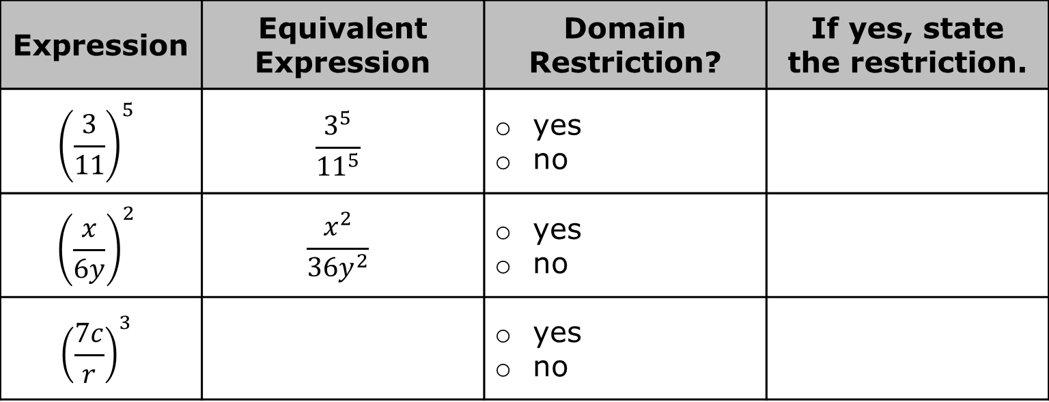
Complete the table.
Expression | Equivalent Expression | Domain Restriction? | If yes, state the restriction.
$${\left(\frac{3}{11}\right)}^{5}$$ | $$\frac{3^{5}}{{11}^{5}}$$ | yes no
$${\left(\frac{x}{6y}\right)}^{2}$$ | $$\frac{x^{2}}{{36y}^{2}}$$ | yes no
$${\left(\frac{7c}{r}\right)}^{3}$$ |  | yes no
volume 1, pg. 65

Slide 19

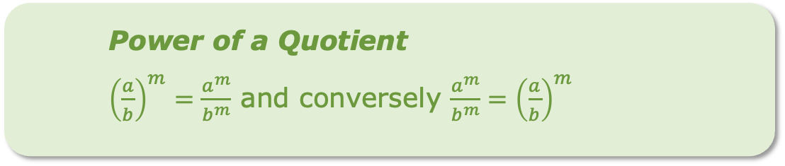
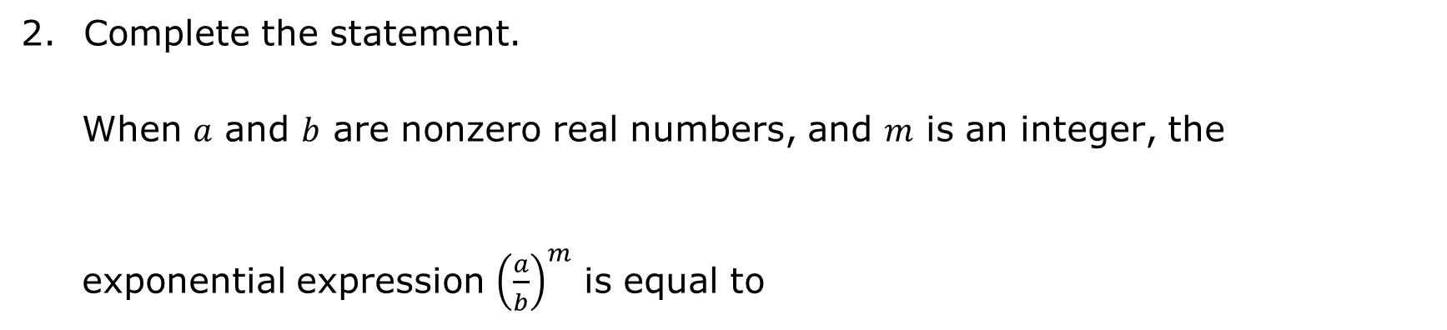
Complete the statement.
When 𝑎 and 𝑏 are nonzero real numbers, and 𝑚 is an integer, the exponential expression ${\left(\frac{a}{b}\right)}^{m}$ is equal to
$a^{b − m}$.
$\frac{a^{m}}{b^{m}}$.
$a^{m}{ − b}^{m}$.
Power of a Quotient
${\left(\frac{a}{b}\right)}^{m}=\frac{a^{m}}{b^{m}}$ and conversely $\frac{a^{m}}{b^{m}}={\left(\frac{a}{b}\right)}^{m}$
volume 1, pg. 65

Slide 20

Activity
volume 1, pg. 66

Slide 21
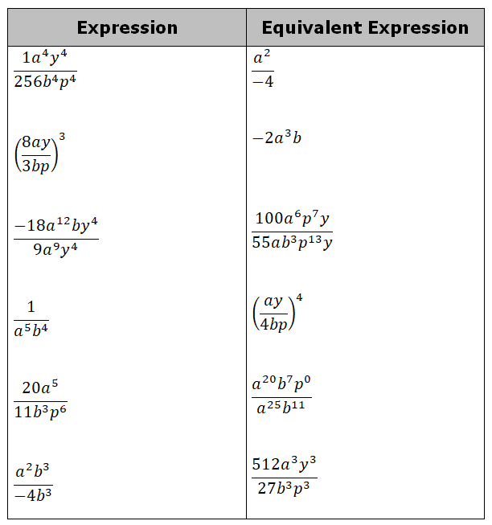
2.2.5 Activity: Matching Equivalent Expressions
Match each expression to an equivalent expression by drawing an arrow connecting them.
volume 1, pg. 66

Slide 22

Your Turn
volume 1, pg. 66

Slide 23

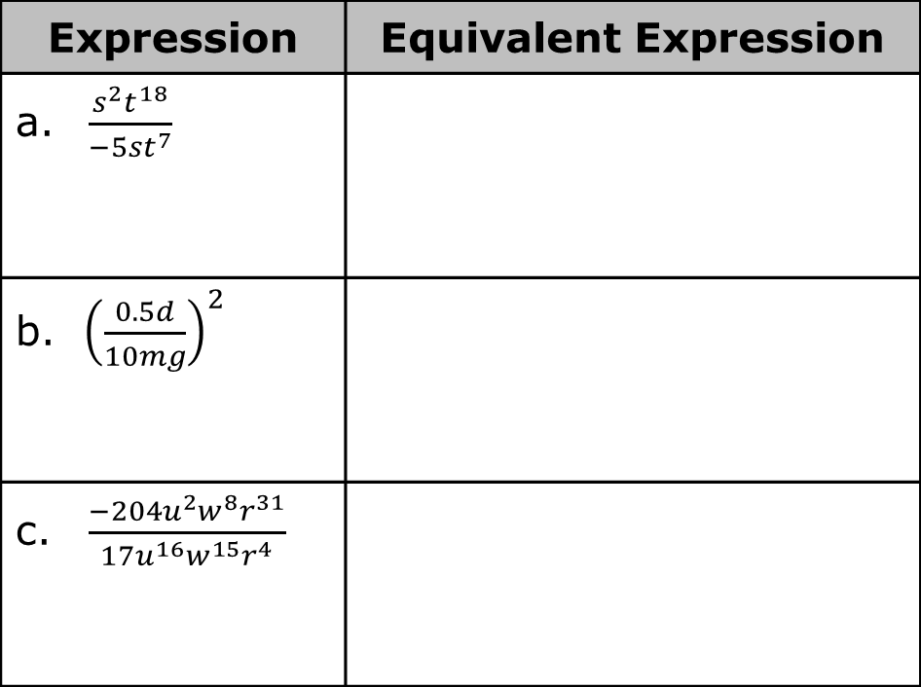
2.2.6 Your Turn!
Find the quotient of each expression by using the laws of exponents to generate an equivalent expression.
Expression | Equivalent Expression
a. $\frac{s^{2}t^{18}}{{−5st}^{7}}$
b. ${\left(\frac{0.5d}{10mg}\right)}^{2}$
c. $\frac{−204u^{2}w^{8}r^{31}}{17u^{16}w^{15}r^{4}}$
volume 1, pg. 66

Slide 24
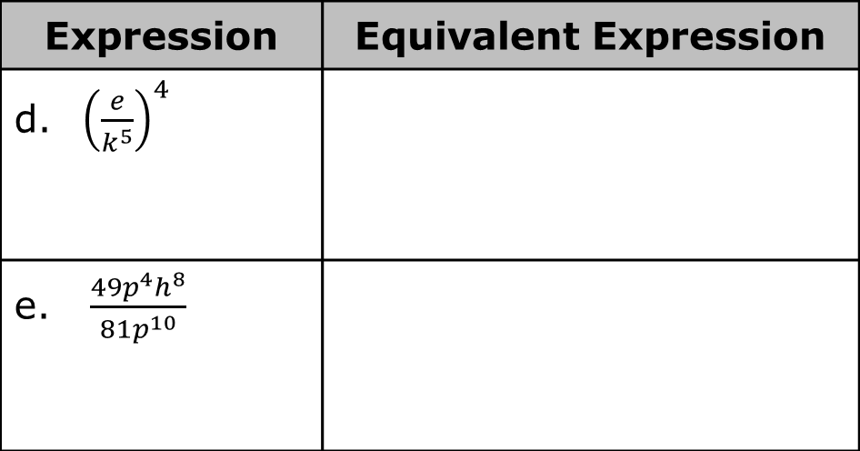
Expression | Equivalent Expression
d. ${\left(\frac{e}{k^{5}}\right)}^{4}$
e. $\frac{49p^{4}h^{8}}{81p^{10}}$
volume 1, pg. 66

Slide 25

Wrap-Up
volume 1, pg. 67

Slide 26

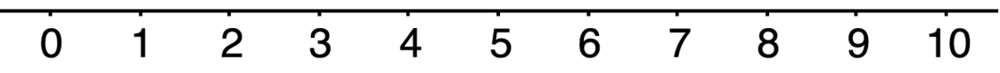
2.2.7 Wrap-Up: Reflection
Choose the emoji that reflects your understanding of generating equivalent algebraic expressions to find quotient of two monomials using the properties (laws) of exponents.
Complete the statement.
I chose this emoji because ________________________________________ ____________________________________________________________________________________________________________________________
volume 1, pg. 67

